Slide 1
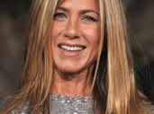
CELEBRITIES

Slide 2
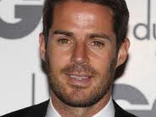
CELEBRITIES

Slide 3
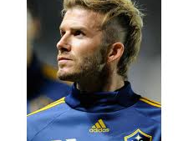
CELEBRITIES

Slide 4
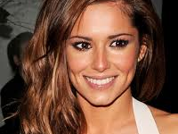
CELEBRITIES

Slide 5
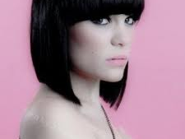
CELEBRITIES

Slide 6
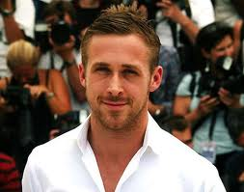
CELEBRITIES

Slide 7
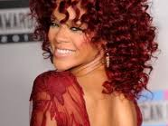
CELEBRITIES

Slide 8
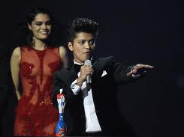
CELEBRITIES

Slide 9
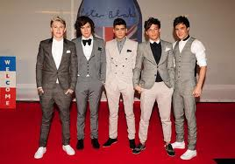
CELEBRITIES

Slide 10
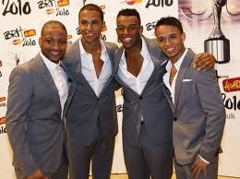
CELEBRITIES

Slide 11
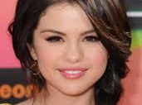
CELEBRITIES

Slide 12
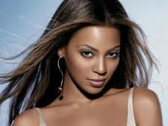
CELEBRITIES

Slide 13

CELEBRITIES

Slide 14
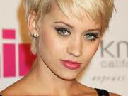
CELEBRITIES

Slide 15
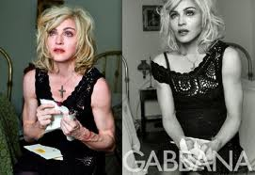
MADONNA
Spot the difference!

Slide 16
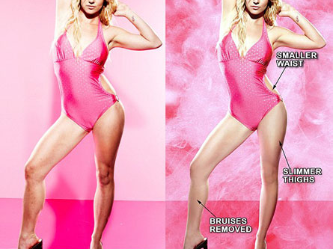
Britney Spears
Spot the difference here!

Slide 17
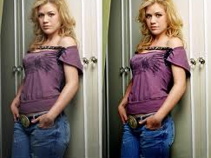
Kelly clarkson
Stomach? Thighs?

Slide 18
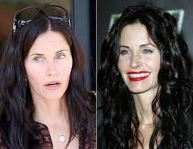
Courtney cox
Professional hair stylist and make up artist?

Slide 19
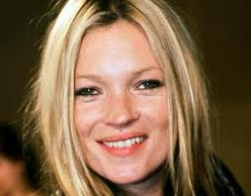
KATe moss
Nothing tastes as good as
skinny feels…

Slide 20
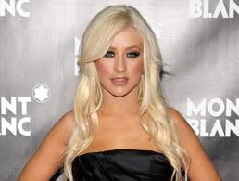
Christina aguilera
I am beautiful, No matter what they say,
Words can't bring me down, I am beautiful,
In every single way,
Words can't bring me down,
So don't you bring me down today.

Slide 21
Which one of these women do you think is happier?
Which one of these women do you think feels the most pressurised?
Which one of these women do you think is influenced the most by the media?

Slide 22
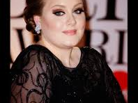
ADELE
TALENTED, FUNNY, CONFIDENT, CREATIVE

