Slide 1
High 5 - Highland Health & Wellbeing programme for schools

Slide 2
What we will cover
How do typical food choices compare with “dietary goals”?
Why factors influence food culture & preferences?
How can school help to develop a healthy food culture?
How can schools support all children to be more active more often?

Slide 3
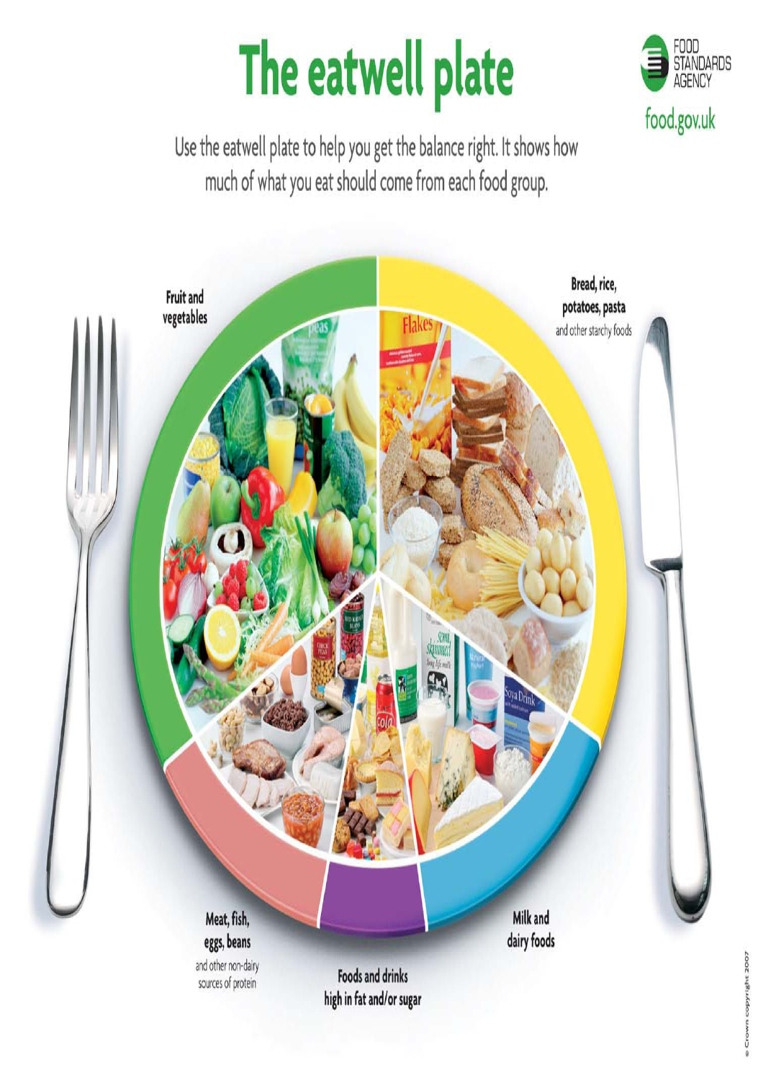
Notes:
3
The Eatwell plate is the best model for visualising what a well balanced diet should look like. We need to eat lots of the top two groups and some of the dairy and protein groups. We don’t need the bottom group but the model shows us that a little is OK.
Are you surprised by the size of any of the foods groups in this model?
(Usually a comment on the size of the starchy food group eg: “I thought bread and potatoes were fattening”. You can add that you may need to limit if you are not physically active and are overweight, but generally, we should be having more of these foods – especially high fibre ones.
Emphasize the importance of variety in the protein and fruit and veg groups as the micronutrients are different (eg: red meat: Iron; beans: fibre; green veg: magnesium; strawberries: vitamin C etc). Variety is less important for the other groups.

Slide 4


Danish Eatwell Plate
Notes:
The Danes have simplified their plate from 5 groups to 3, using the letter “Y” to indicate that the protein group (which includes cheese) need not be large. 3 groups is easier to relate to meal planning

Slide 5
Brazilian Guidelines
Make natural or minimally processed foods the basis of your diet
Use oils, fats, salt, and sugar in small amounts
Eat regularly… and whenever possible, in company
Shop in places that offer a variety of natural or minimally processed foods
Develop, exercise and share culinary skills
Plan your time to make food and eating important in your life
Out of home, prefer places that serve freshly made meals
Be wary of food advertising and marketing

Slide 6
Healthy Eating guidelines
Fruit & veg
Starchy foods
Calcium rich dairy
Protein
Fatty/
Sugary
foods
Notes:
6
Taking the pictures away, this is what a healthy, balanced diet should look like. How do you think this compares with the diet of a typical child in a Highland primary school?

Slide 7
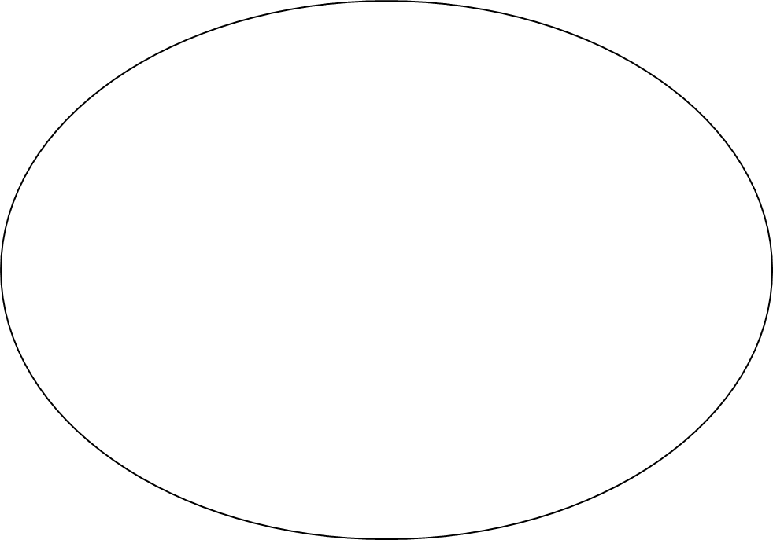
Average for Highland Children
Fruit & Veg
Starchy Foods
Protein
Fatty / Sugary foods
Calcium Rich Dairy foods

Slide 8
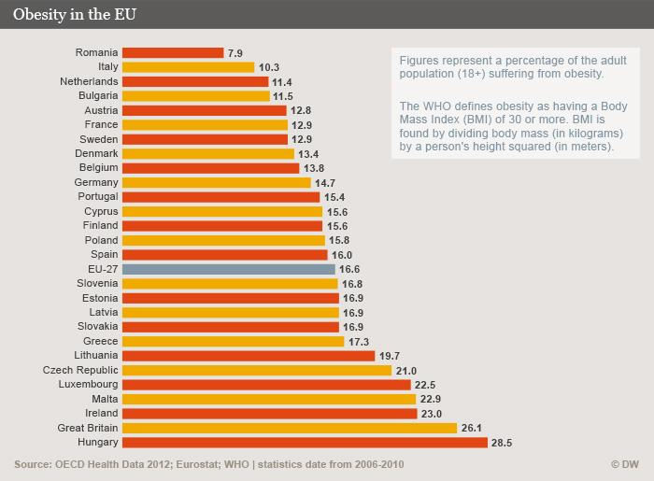

Slide 9
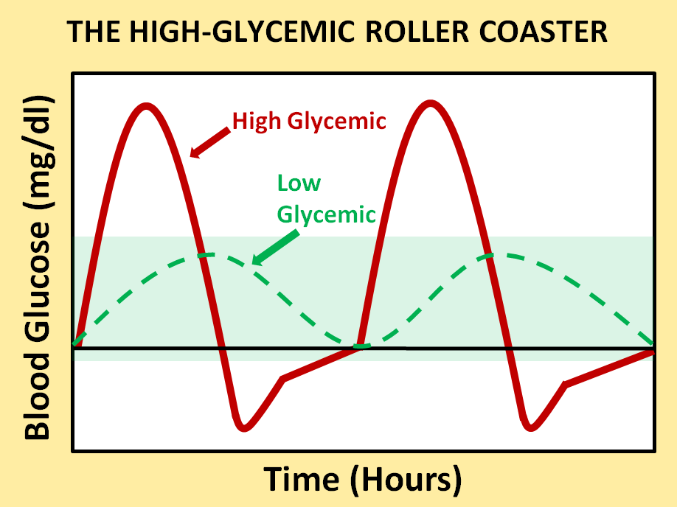
The Sugar “Roller Coaster”
(More fibre & limit sugar)
Sugar
Fibre
Blood Sugar Level
Calm & focused
Poor mood & concentration
Time of day

Slide 10

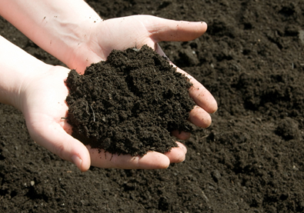
Air
(CO2)
“Nutrients” in soil
(Nitrogen, phosphorous, sulphur, magnesium, calcium, potassium etc)
A tree needs 17 nutrients
You need 40 Nutrients!
Notes:
.

Slide 11
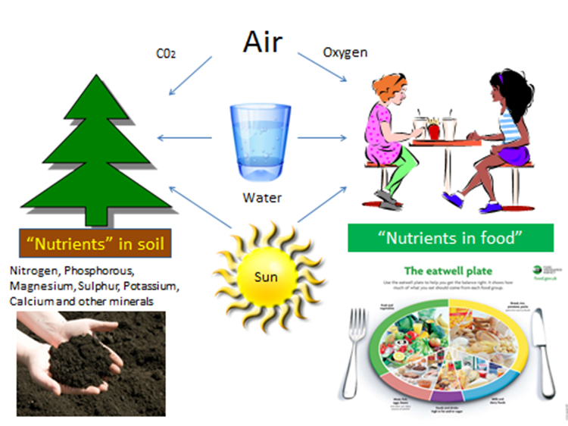

Slide 12
Nutrients often lacking in the diets of Scottish Teenagers
Nutrient | Impact
Iron | Mood, healthy blood
Magnesium | Mood, healthy heart
Zinc | Concentration, sleep, immune system, digestion
Folic Acid | Mood, sleep, healthy heart & blood
Vitamin A | Mood, healthy eyes & heart
Vitamin D | Mood, healthy bones, immune system
Omega 3 | Mood, concentration, healthy heart, immune system
Fibre | Mood, healthy gut & heart
How many of these “Nutrients” affect the brain?
Notes:
These nutrients are often lacking in the diets of teenagers in Scotland. Not having enough of then affects our long terms physical health. For example heart disease, strokes and cancer are all common causes of early death and illness that can be caused by a poor diet (and by other things too – Inactivity, luck, genetics, smoking, alcohol, drugs etc).
Lacking these nutrients can also affect our health now. It can especially affect how our brains work. That means that our concentration, mood and sleep can all be affected. Getting you diet right can help you to learn, concentrate, be happy, relax and sleep. How many of these things do you sometimes find hard to do? There could be lots of reasons, but your diet can be one of them.

Slide 13

Behaviour: ADHD-type symptoms
Richardson AJ & Montgomery P. Pediatrics, 2005, 115:1360-6
Notes:
This slide shows the difference that omega 3 fats from oily fish can make to ADHD symptoms. Notice the difference between the red and the green. Red is fish oil, green is a placebo “dummy” treatment. This shows how important essential fats are for the brain.

Slide 14
Why children eat the way they do
School /nursery food policy
Shops
Parenting style
Psychology of the child
Peer food culture
Financial resources
Family food culture
Catering outlets
Advertising & marketing
Notes:
14
Its all very well, us complaining about how unhealthy the food choices of children are. But food preferences are merely the result of the interplay between all these different factors. Some of them we have some control over, and some less so, some of them are good influences, but most of them are not. Specifically, advertising and marketing is disproportionately for high fat or high sugar foods of low nutritional value. The lesson plans for upper primary that we will be looking at, help pupils to develop the kind of critical consumer skills that are essential for developing resilience to the marketing of foods of low nutritional value.

Slide 15
Cost of a healthy diet
Cambridge University study:
  “Healthy” foods 3 times price of “unhealthy”
  Gap in price is widening
Skills in planning, shopping, cooking & parenting only partly reduce the impact of income

Slide 16

Beyonce’s $50million dollar shopping trolley

Slide 17
What can be done at school to influence food culture?

Slide 18
How to influence child food preferences
Food choices depend on:
  Our food environment
  How we feel about food
  Our skills & resources
  Knowledge about nutrition
Food culture is a healthy as the weakest link

Slide 20
Food & Health learning in Highland schools

Slide 21
Food as Celebration & Reward
How often do you use food as a reward or to mark a celebration?
How often are these the kinds of foods we should be eating more of?
Can nutritious foods be included?
Can non food rewards be used?

Slide 22
Primary High 5 programme
Builds knowledge & skills
Influences attitudes
Part of “Child Healthy weight strategy”
No more weighing!
Less controversy
Minimal paperwork
Needs 8 sessions in 1 term

Slide 23
Knowledge of health specialists
Skills of teachers
Experience of the pilots
High 5 Health and wellbeing programme
Notes:
The High 5 Health & Wellbeing programme is a vital part of the solution to the poor lifestyle choices of children. It brings together our knowledge, the experience of the pilot schools, and your skills as teachers to deliver a programme that meets the needs and learning styles of your pupils.

Slide 24
Principles
Food is good for you!
Getting active is as important as eating well
Healthier choices at any weight
Knowledge, skills and attitudes (Head, hands and heart)
Avoid “good” and “bad” foods
Respect differences (money, culture, medical need etc)
Acknowledge environmental barriers to food and physical activity
High fat / sugar foods are not “treats”!
Avoid food snobbery
Involve your cook
Explore new food cultures
Involve parents
Notes:
We have lesson plans that are fully developed. They can be followed to the letter, adapted to suit the needs of your pupils or used more loosely as inspiration. What ever your 8 session program looks like, pay attention to the following principles. These are fully described in the “Key principles of High 5” document on your CD in the High 5 general explanatory notes folder. Talk through the princples, one by one.

Slide 25
Physical Activity
Enjoy moving our bodies
Reflect on how physical activity makes you feel different
Discuss opportunities and barriers for activity
9 of the session plans include Physical activity messages
Minimum of 2 sessions to include physical activity messages
Link learning to PE and “Active Schools”
Notes:
Physical activity is every bit as important as nutrition in the High 5 program. Within your 8 sessions, there are key physical activity messages that need to be communicated through both theoretical and experiential learning. Make sure you read the “Physical Activity – Key points” document before planning your program. At least two of your 8 sessions should have a substantial element of physical activity promotion. That is in addition to including reference to its importance in both the first and last session. The example lesson plans for P1 & 2 have simple, fun activities embedded into the lessons. In addition, one of the Active Schools co-ordinators has included 2 lessons on physical activity that can be used for any age (though the first of these may need adapting for older pupils). There are also a couple of physical activity lesson plans specifically designed for older pupils, one of which is integrated with learning about food groups and body parts. Once again, you don’t have to use these, as long as you get the key messages across and don’t forget to echo these messages in PE lessons.

Slide 26
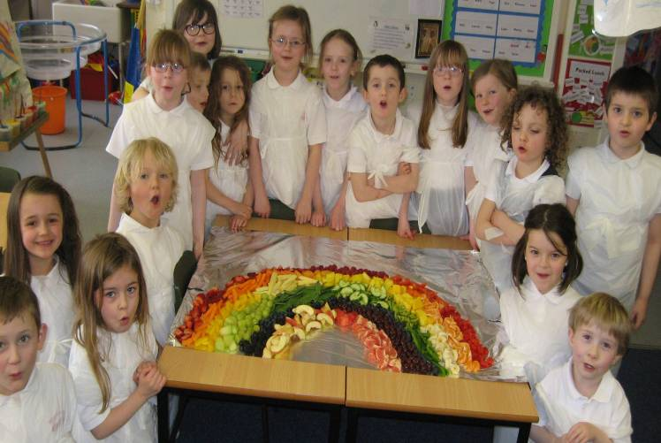
Taste the rainbow – Temptation!

Slide 27
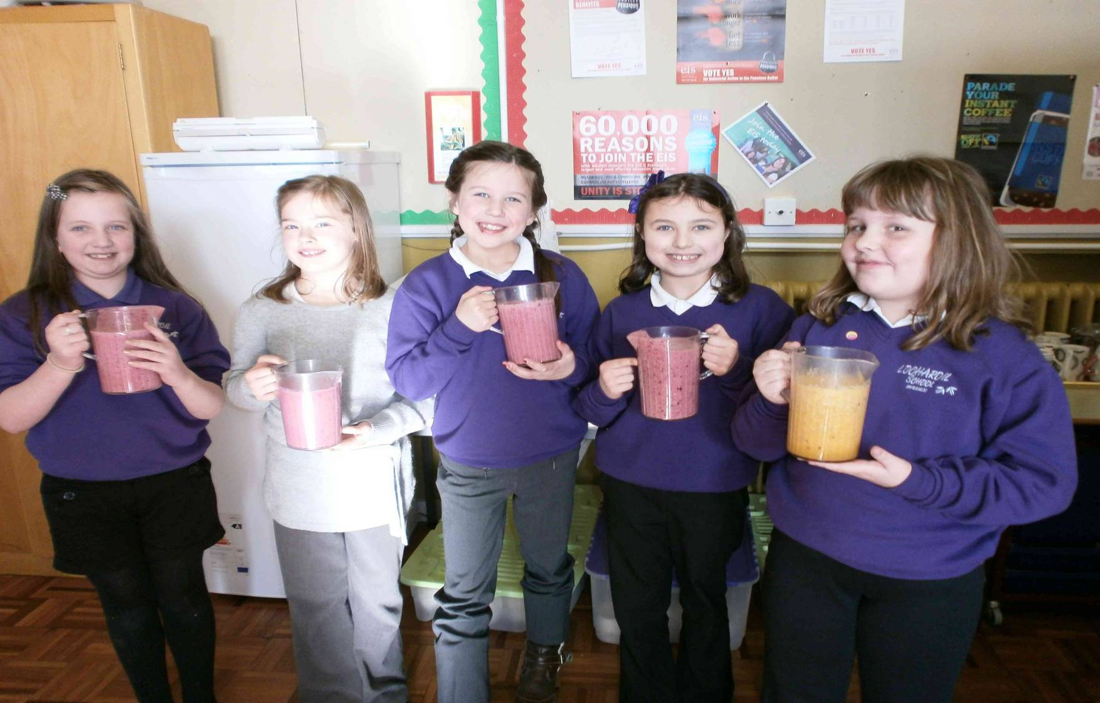
Smoothie makers
Notes:
Another story on your “Eat Your Words” DVD being used here is the “Rosey Parker Investigates” one which finishes with pupils making a smoothie. This class have made their own as part of a “5 a day” lesson plan which works well with P3 and P4 pupils. In primary 1 and 2, you can keep the message even simpler with a “Taste the Rainbow” message, which itself is another story on the DVD.

Slide 28
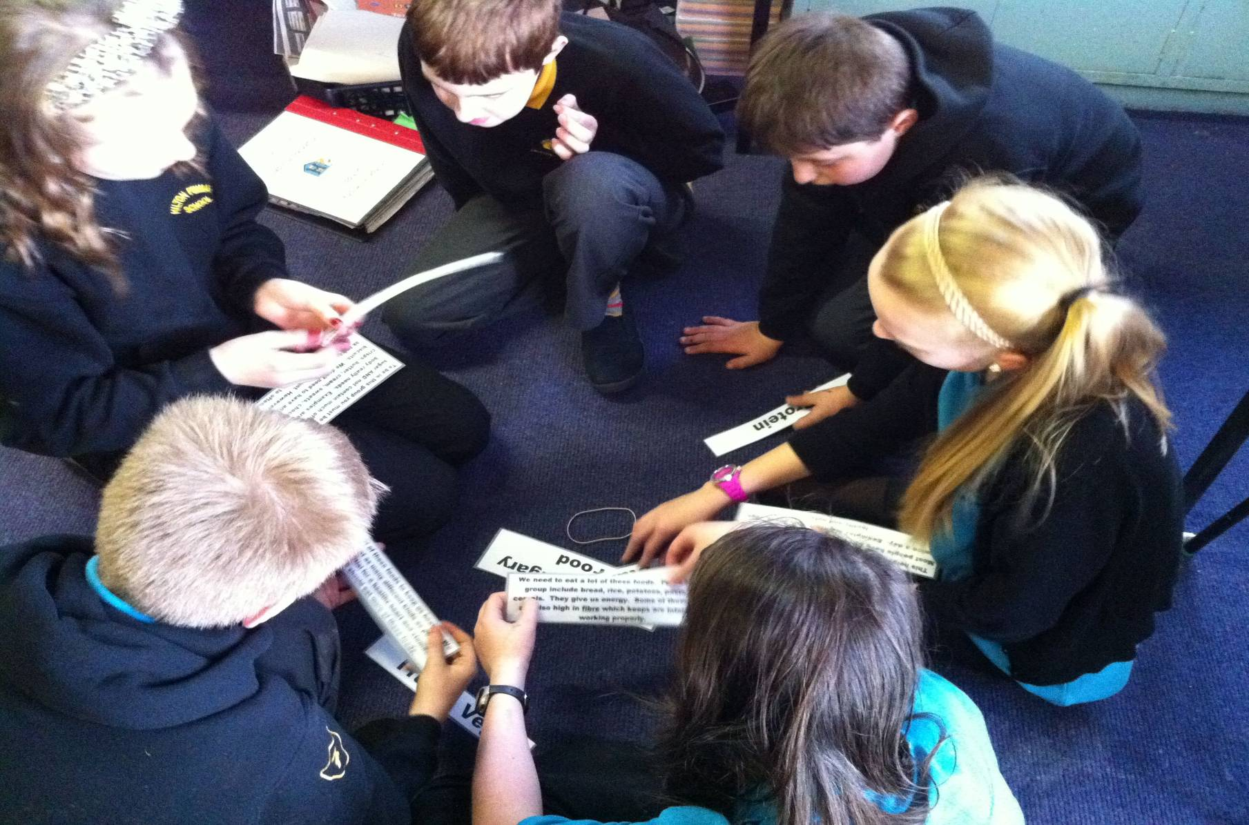
Eatwell Plate & the concept of “Balanced diet”
Notes:
The Eatwell Plate is a really important foundation for the mid primary years. It still needs to re-enforced in upper primary. This picture shows primary 7 pupils matching the description of each food group with the name of the food group. The text for these laminated cards was just copied from the extra guidance notes and, if you look in the appropriate Eatwell lesson plan folder, you’ll see these descriptions already formatted and ready for you to print off and cut up…just to make it easier for you and avoid having to duplicate the effort.

Slide 29
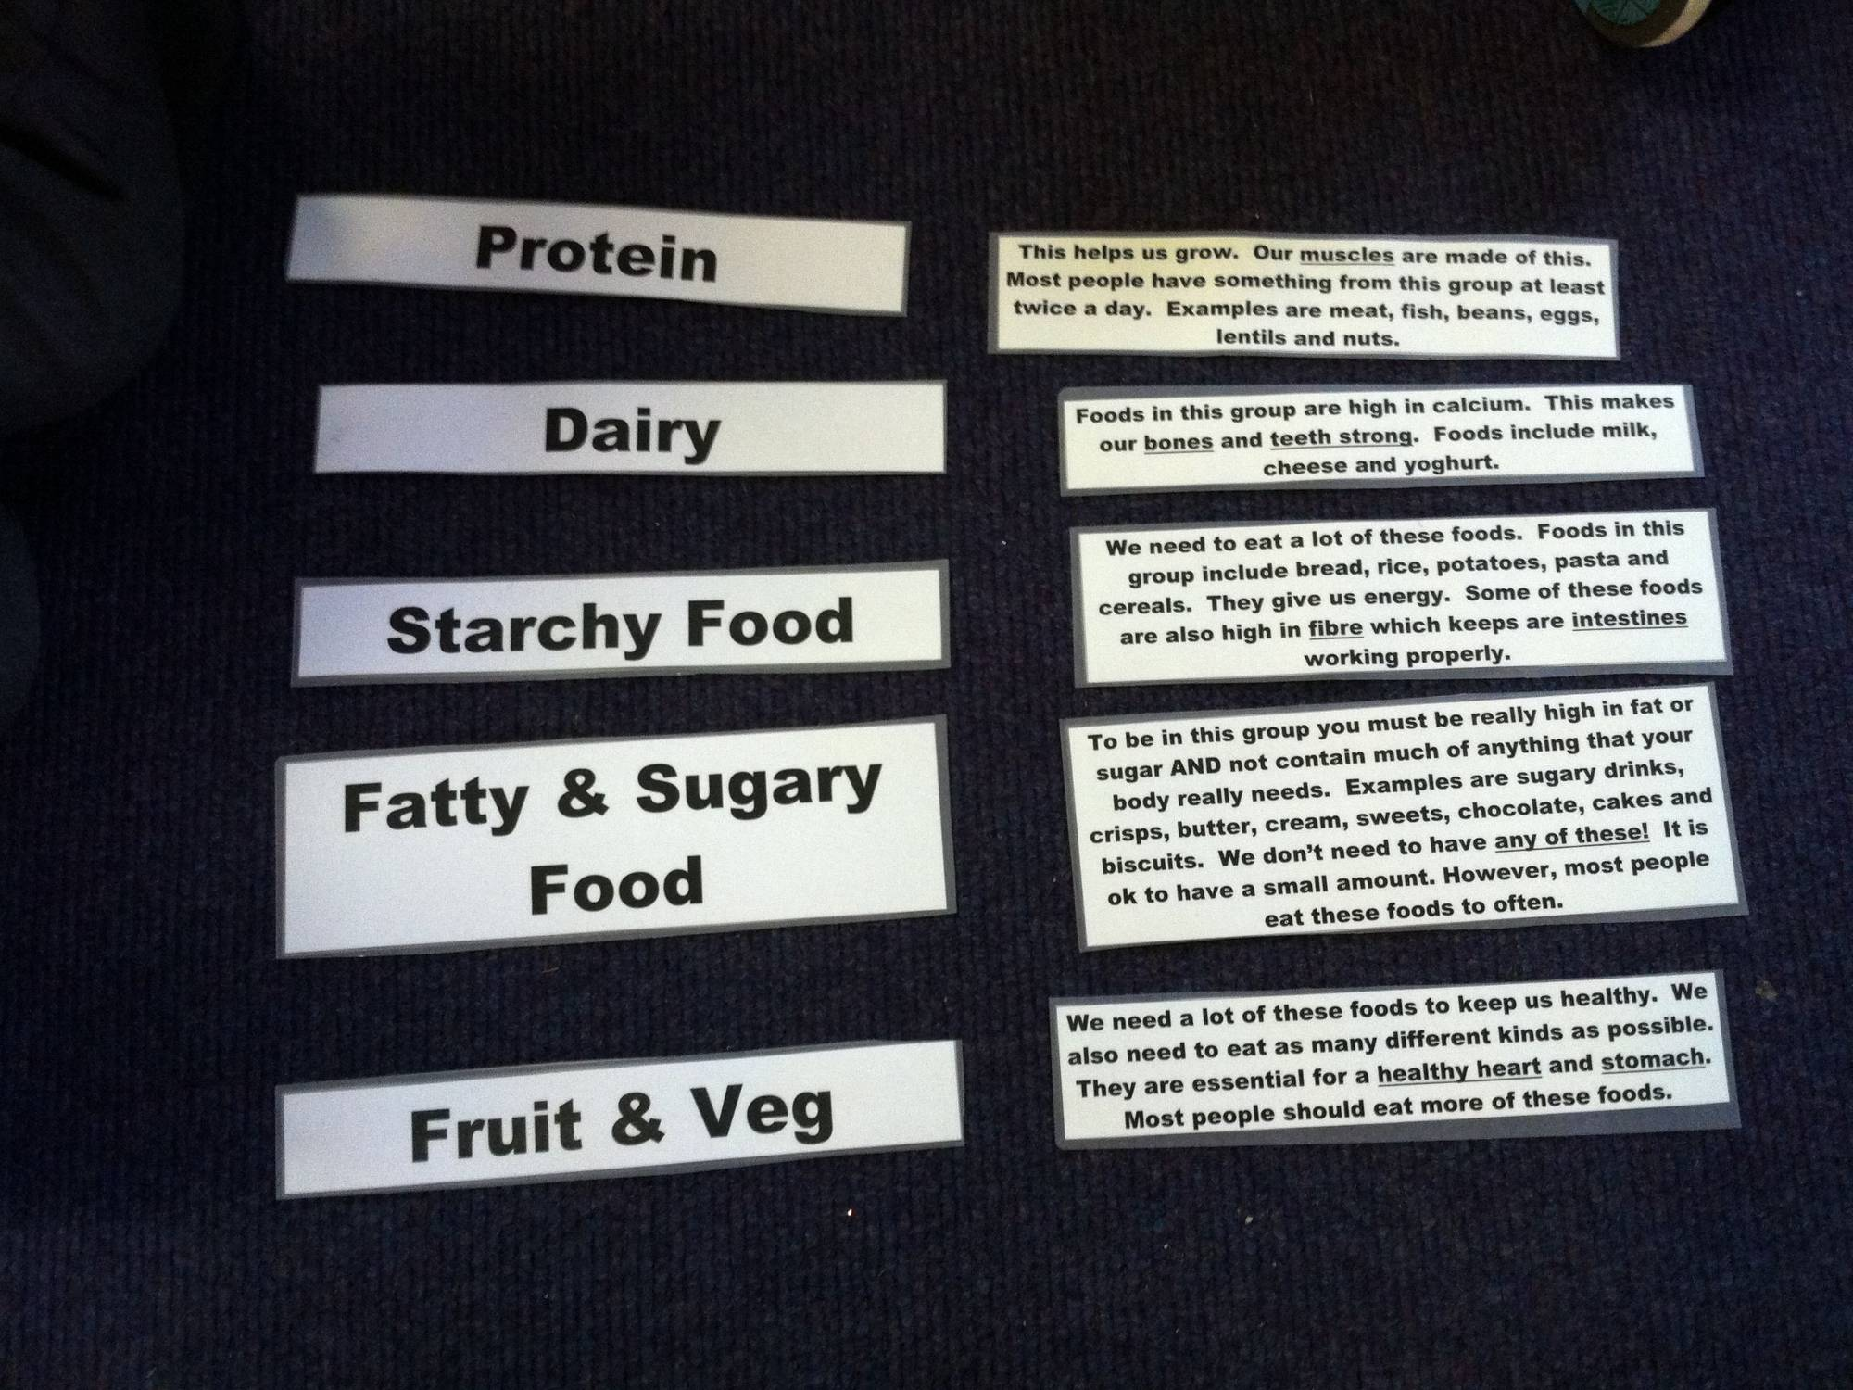
Notes:
And here are the 5 food groups correctly matched up with their descriptive text.

Slide 30
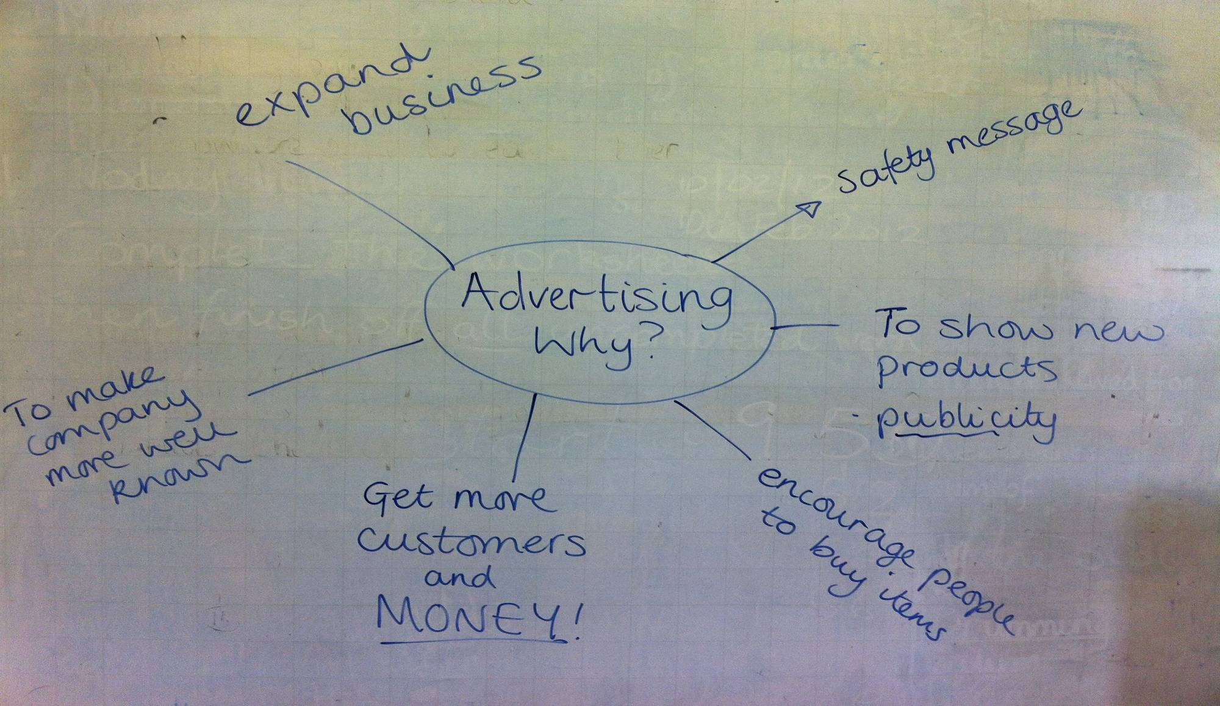
Food advertising vs Eatwell
Notes:
This picture shows you how a primary 7 teacher gathered the pupils thoughts about food advertising as part of the “Food marketing and your health” lesson plan for mid to upper primary pupils.

Slide 31
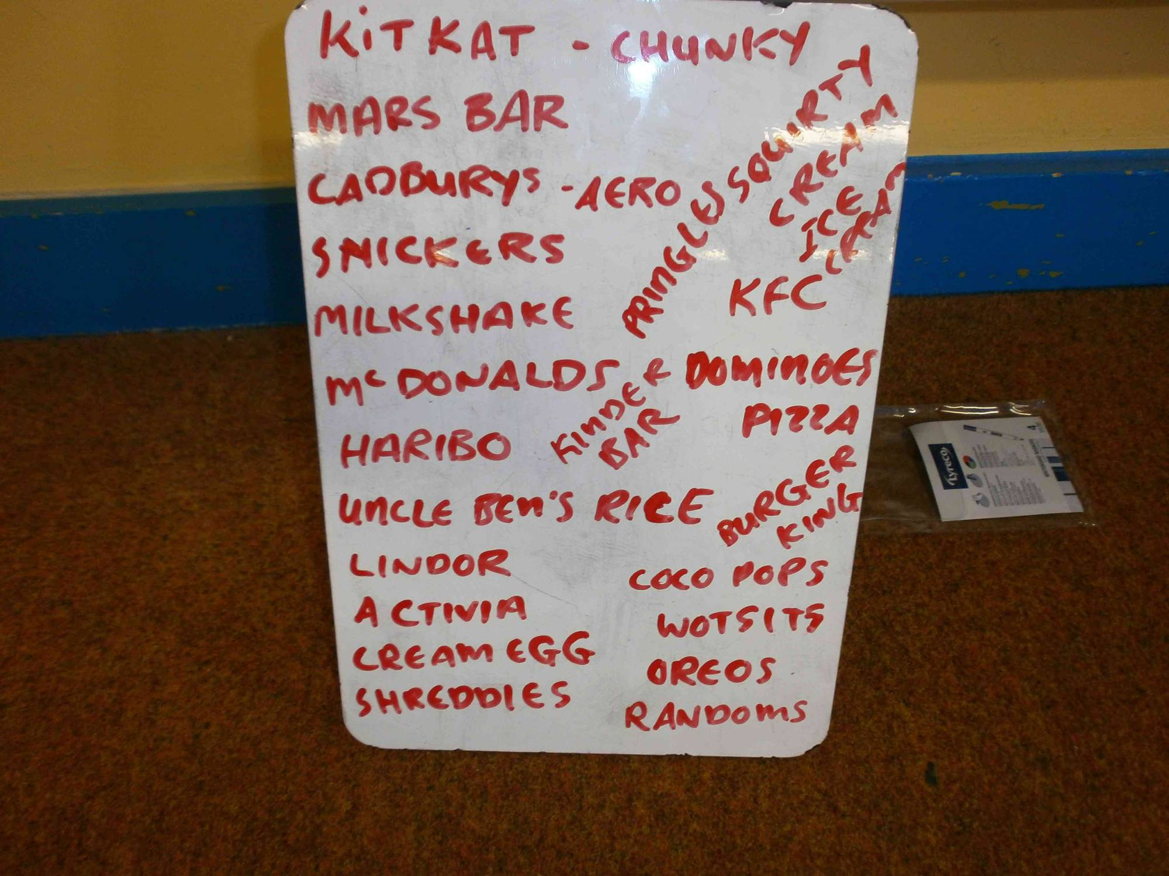
Notes:
Pupils were asked to recall as many food adverts as they could. Here are some examples from a primary 4 class.

Slide 32
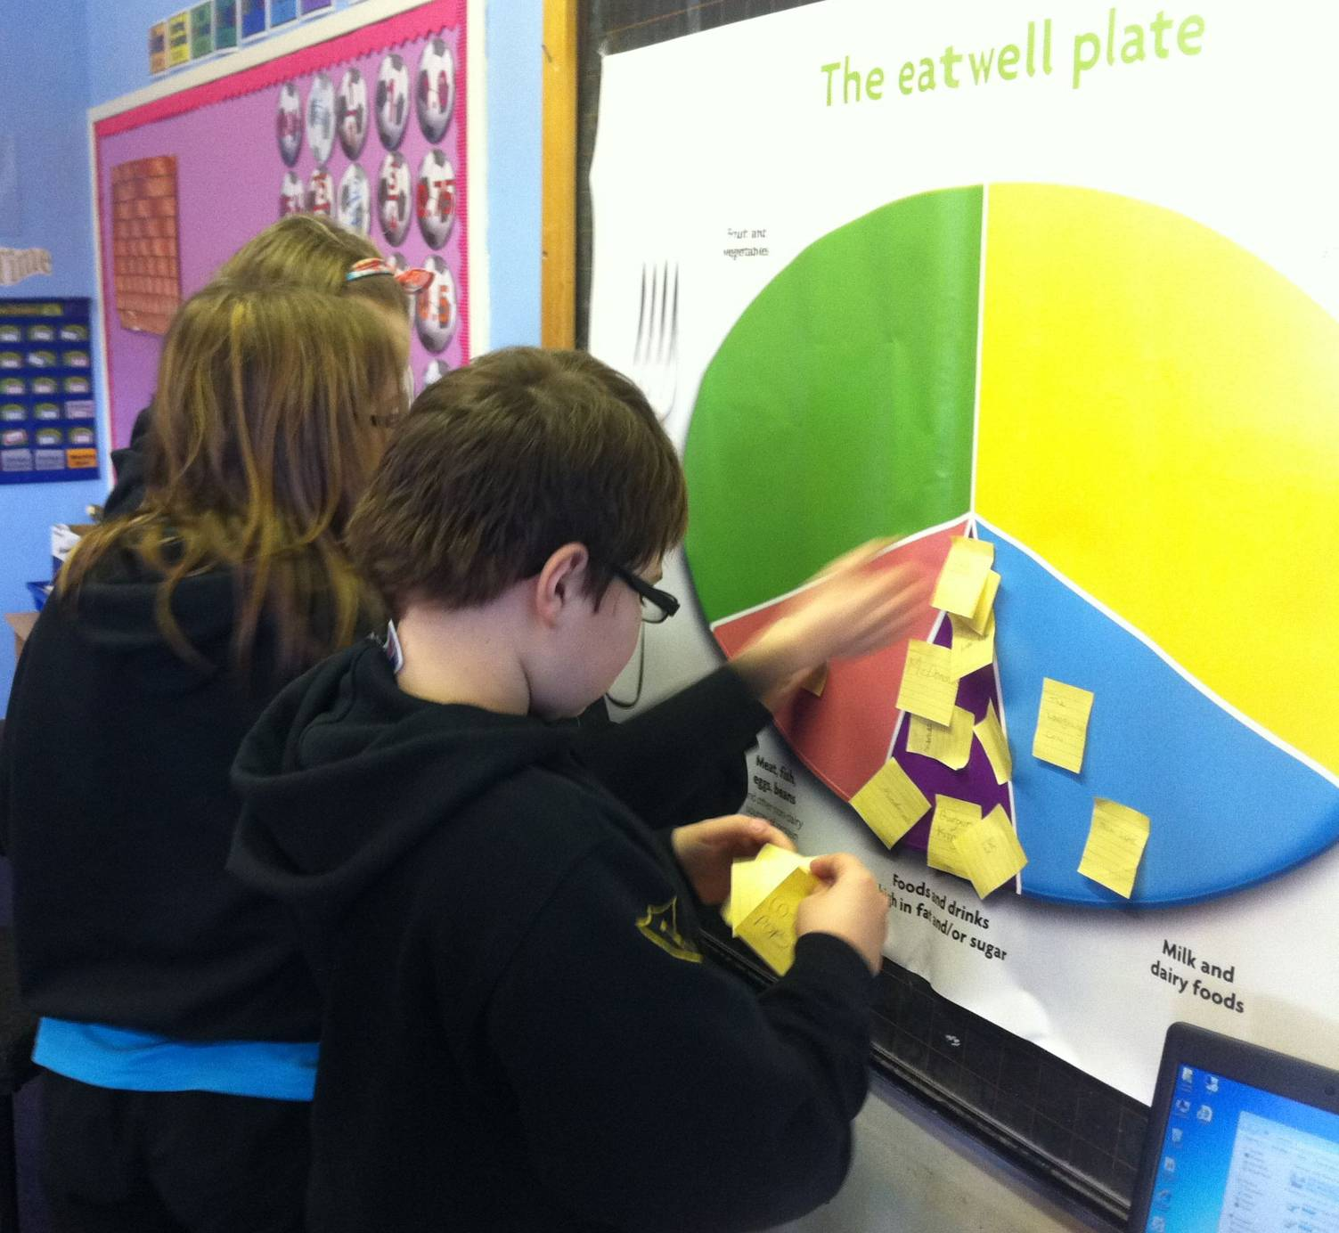
Notes:
Here are some primary 7 pupils putiing the food adverts into the appropriate section of the Eatwell plate.

Slide 33
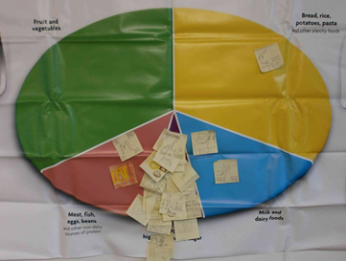

Slide 34
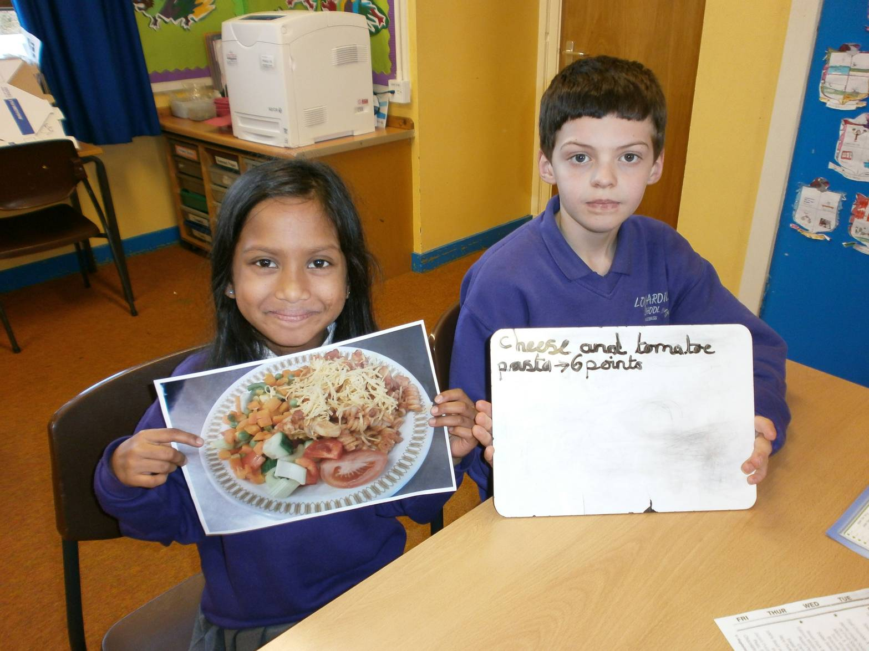
Rising Stars
Notes:
Here are some primary 4 pupils at Lochardil, evaluating how well balanced school meals are using the “Rising Stars” model. They did the same with packed lunches and home lunches. In fact, the model can be used for rating any meal and is suitable for P4 upwards – but only if they have a good grasp of the Eatwell plate first.

Slide 35
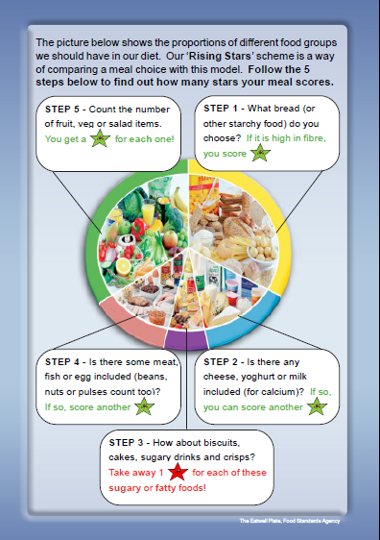
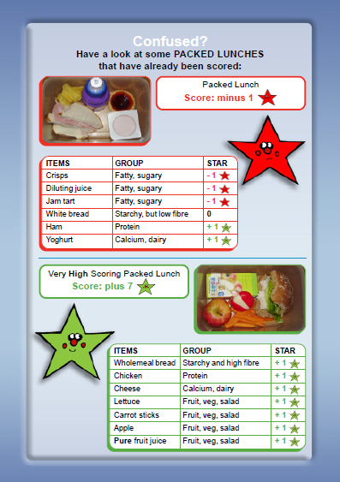

Slide 36
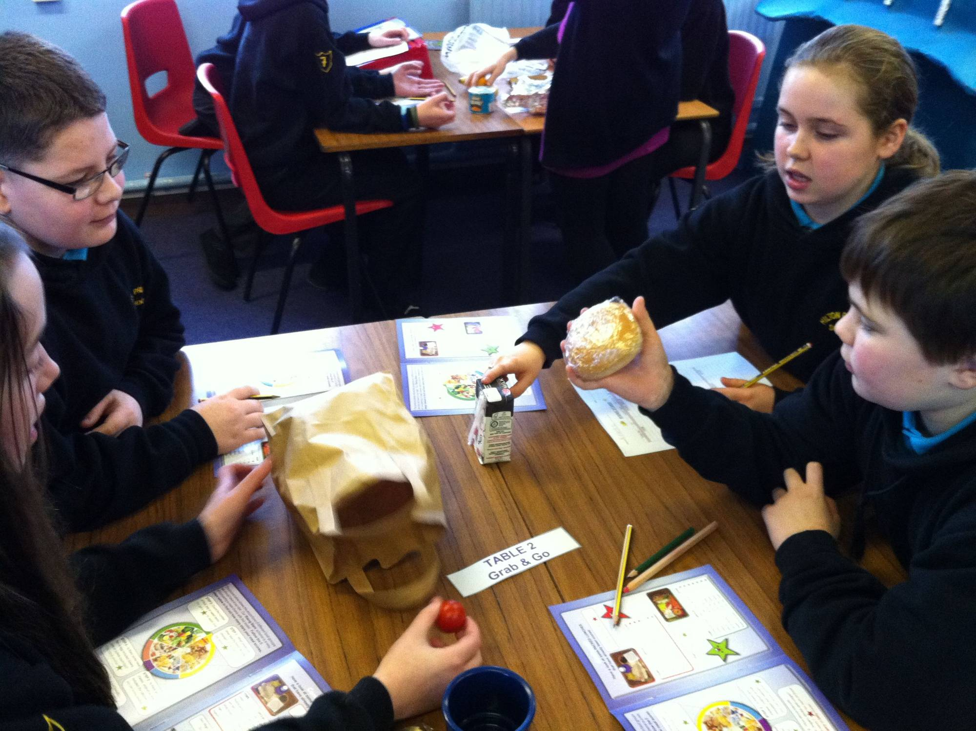
Notes:
Here are some older children practising the Rising stars scoring system.

Slide 37
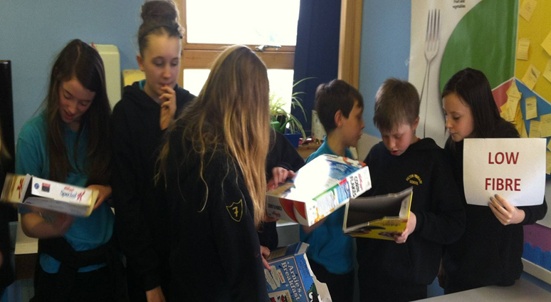
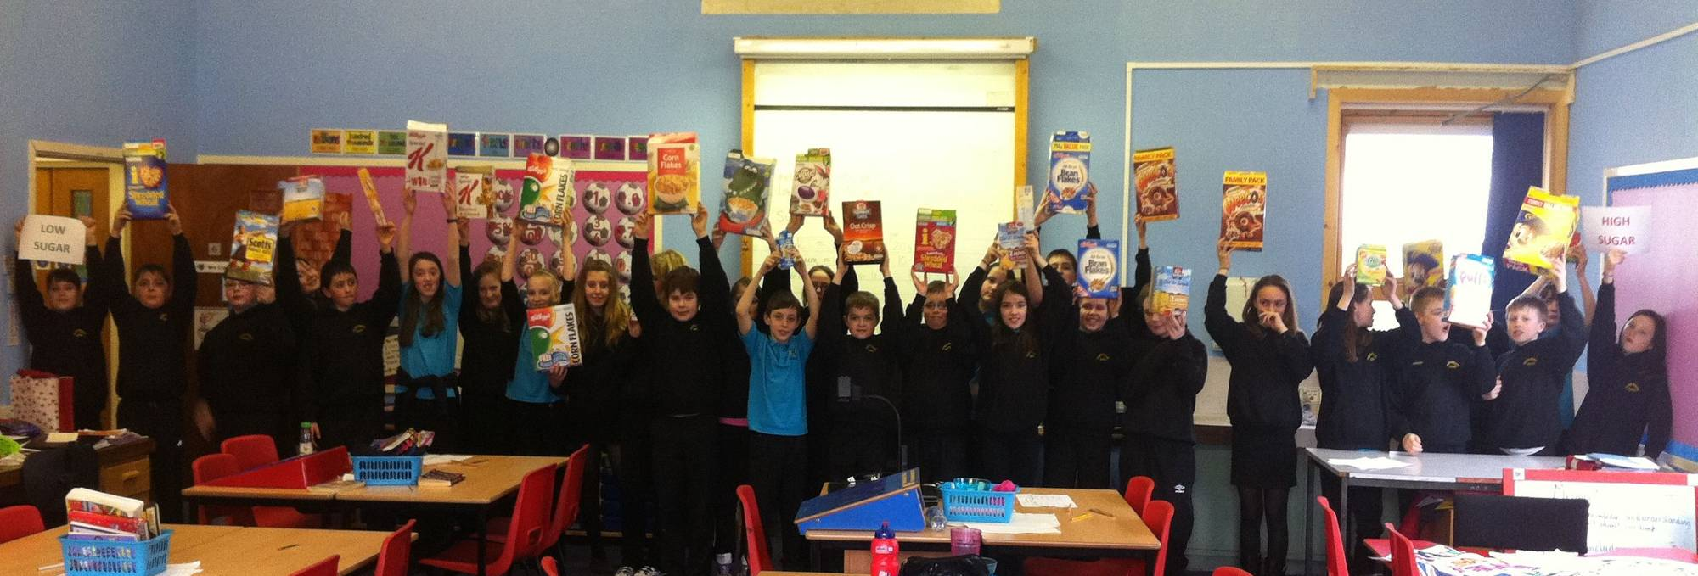
Critical consumer skills

Slide 38
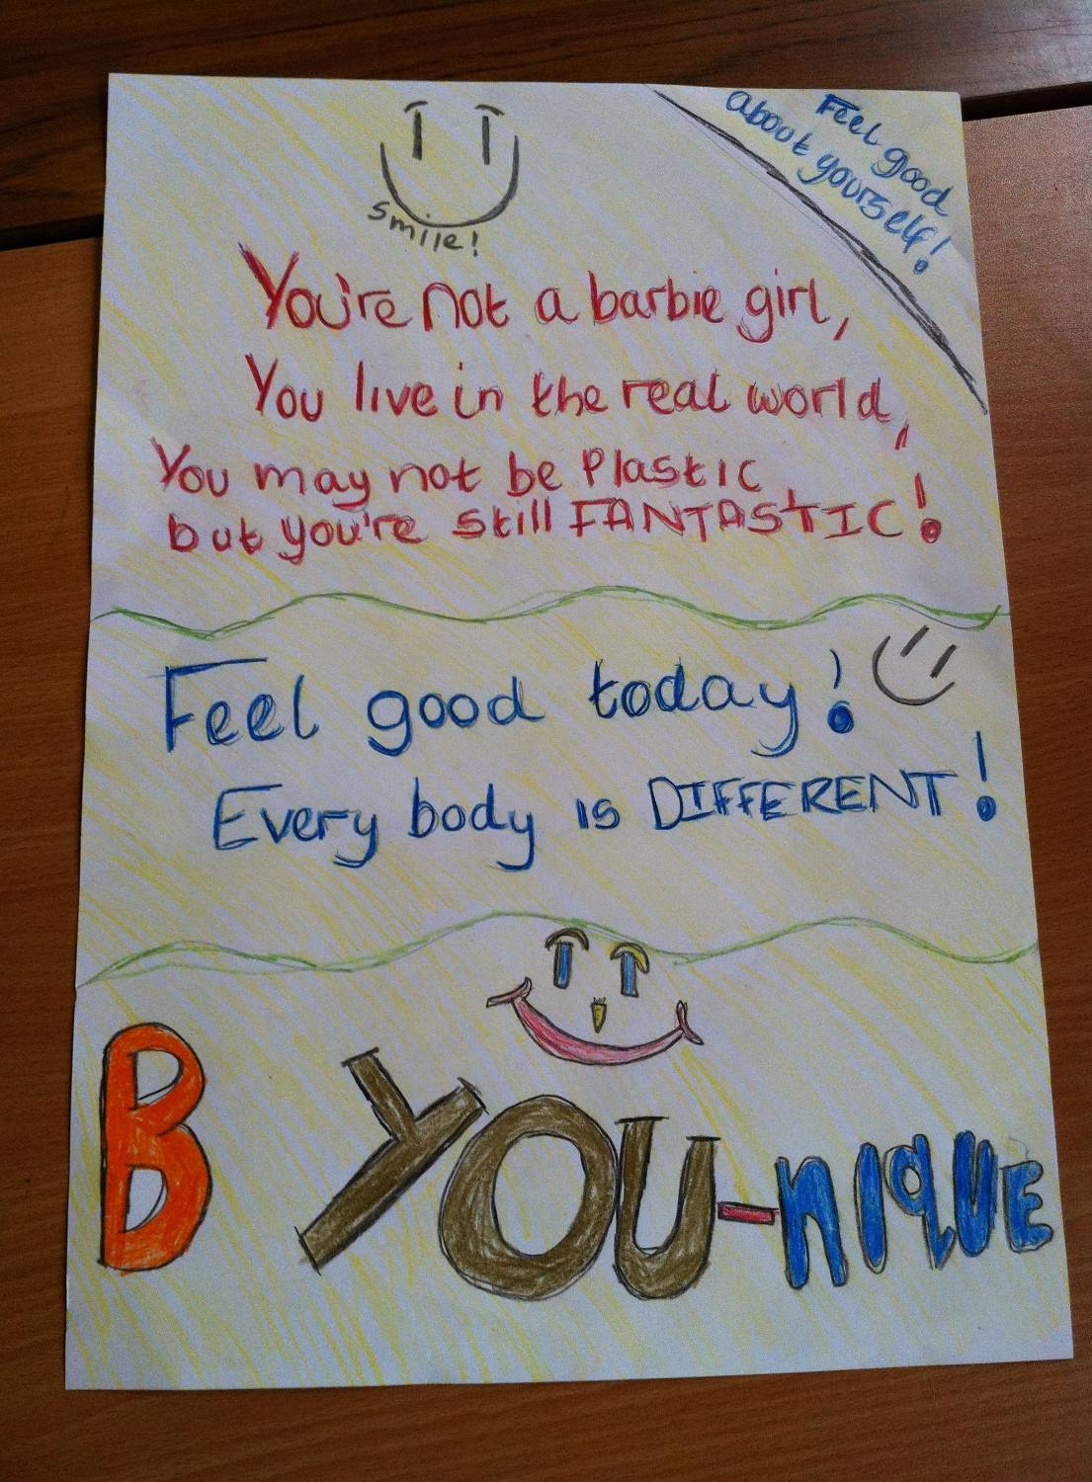

Slide 39
Lesson plans
22 lesson plans
Have been piloted
Can be followed literally
Can be adapted
Include extra guidance notes
Need to be sequenced properly
Can add your own sessions
Notes:
Explain we will have a chance to look at some of the lesson plans. To do this, it might be better to spit the participants into P1, 2 in 1 group, 4 and 5 in another, and 6 and 7 in the other. The P3 teacher may want to float between the two younger groups. Go through the bullets above.
Explain that the write of the lesson plans includes learning outcomes, E and O’s of CFE and various other headings. However, for clarity, the ones you are handing out for staff to look at include only the suggested learning and teaching activities and any relevant extra guidance notes. Briefly show the participants on the whiteboard how the folders on their CD are organised by dipping into the lesson plan folders (both the full ones and the simplified ones you are handing out for them to look at). While you’re at it, show the “General explanatory notes folder” and the flow chart document stressing that they need to read through all of these before they plan their sessions.

Slide 40
High 5 and Different Year Groups
Early Primary: Do your own thing – but follow CfE E’s and O’s and High 5 principles and involve parents
Mid Primary: More sophisticated messages – ideas of balance and influence of the media
Upper primary: Development of critical consumer skills
Notes:
Looking primarily at the teachers of P1 & 2 classes, explain that the lesson plans they have should be used more as an example rather than taken literally. Go through bullets above.

Slide 41
Key documents
Guiding principles
Healthy weight principles
High 5 data form
Lesson plans
Resources list
High 5 evaluation form
Guidance on Rewards & Celebrations

Slide 42
Summary
Our food environment and culture are not as healthy as they could be
Schools are leading the way
High 5 can improve knowledge, skills & attitudes of children

