Slide 1
Caffeine vs water slides

Slide 2
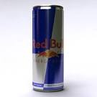


Limit your caffeine intake
Daily caffeine & added sugar limit in just half a 500ml can of energy drink
Too much caffeine: Stressed, sweaty, shaky & poor sleep
Avoid tea, coffee, Irn Bru, colas & energy drinks after school

Slide 3

Drink water
Pure
Free
No sugar
No caffeine
No additives

