Slide 1
Blood glucose, mood & effect of fibre & sugar

Slide 2
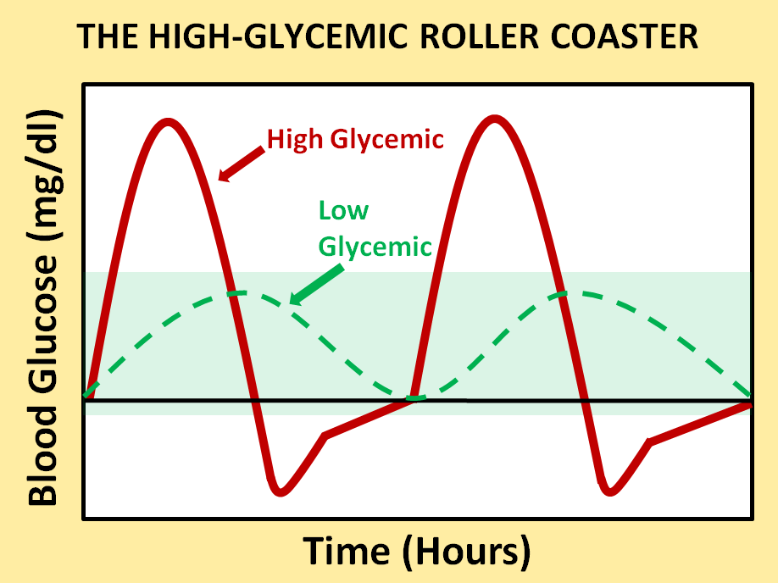
The Sugar Roller Coaster
Sugar
Fibre
Calm & focused
Poor mood & concentration
Notes:
You can use this slide to help pupils understand how the amount, timing and type of food they eat affects their mood and concentration in the short term. It compliments the breakfast cereal lesson plans in particular.
Explain that it is normal to have sugar in our blood.
When we digest food, the break it down and the level of sugar in our blood goes up.
We call this sugar “glucose”.
If we eat lots of sugary food but not much fibre, the glucose in our blood rises quickly but falls very quickly too (red line).
A rapid fall in blood glucose happens and hour or two after eating high sugar foods that are also low in fibre.
Can they name a breakfast cereal that might have this effect?
Also, if we skip breakfast, our blood glucose is low when we wake up, but is gets lower during the morning.
When our blood glucose falls too fast, we become grumpy and find it hard to concentrate. (Click through the slide so that the green and red bars with writing appear)
If we eat food that is high in fibre, it takes longer to digest. This means that our blood sugar rises more slowly and falls more slowly (Green dotted line).
What could we have for breakfast that is high in fibre and takes a long time to digest?
How would we feel if we only ate high sugar foods that are low in fibre?
How would we feel if we skipped a meal completely?
What other meals would help keep us calm and focused?

Slide 3
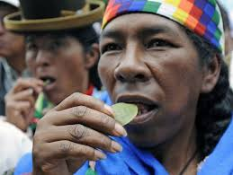
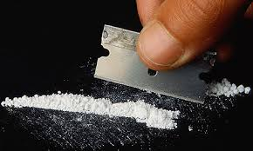
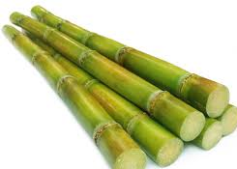
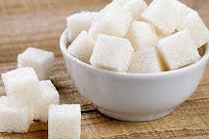

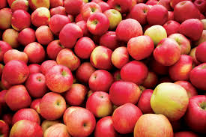

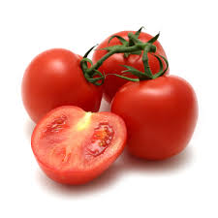
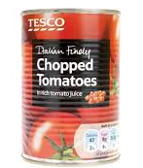
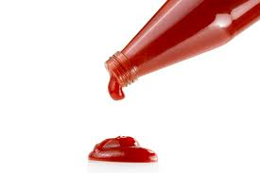
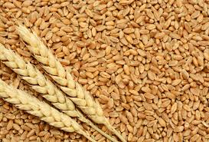
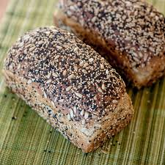
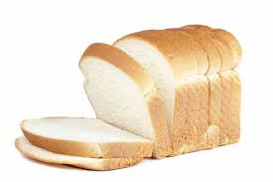
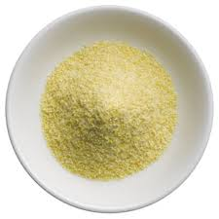
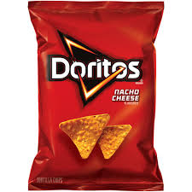
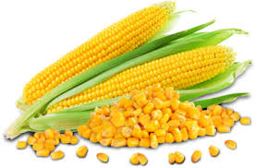
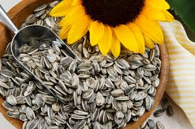
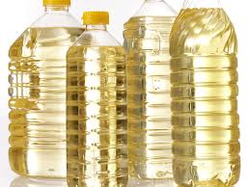
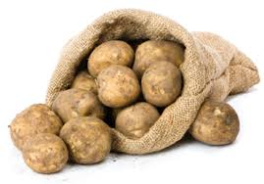
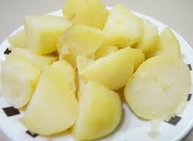
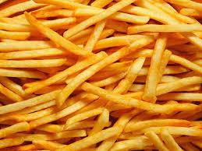
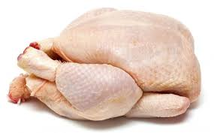
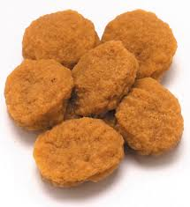
What gets removed?
What gets added?
Which can you eat to excess?
Notes:
The first 2 pictures are coca leaves and cocaine. The point here is that communities native to the mountains of South America have used coca leaves as a stimulant for hundreds of years. The level of harm caused when these leaves are processed into cocaine, is of course much greater. Its stronger and chemical are used in its production. Similarly, as each food gets more heavily processed, we lose more nutrients and fibre, but add more fat, sugar, salt or chemicals. Some transformations are fine and just practical. For example, wholemeal bread is easier to eat and digest than wheat grains. Canned tomatoes are convenient in winter. However, usually, as foods get more heavily processed, they lose their nutritional benefits and instead become convenient commodities that are profitable to transport, store, advertise and trade, but not so good for our health. Eating fewer processed foods is therefore a good principle to stick to.

