Slide 1
Varied, regular eating - a resource to support Food & Health learning as part of Broad,General Education
Learning Outcomes:
To understand the importance of a varied diet (by analogy with plant health & soil).
To understand the importance of eating regularly, and not skipping meals (using the “Sugar roller coaster” graph)
NB: Each slide has detailed teacher guidance notes – click on “view” & choose “Notes page”

Slide 2

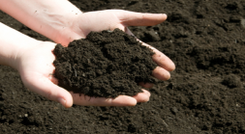
Air
(CO2)
“Nutrients” in soil
(Nitrogen, phosphorous, sulphur, magnesium, calcium, potassium etc)
A tree needs 17 nutrients
You need 40 Nutrients!
Notes:
This slide compliments the Eatwell, physical activity and body parts lesson plan and the Eatwell Plate lesson plan.
As you click through this slide, it shows pupils what a tree needs to grow into a “healthy, happy tree”. (We say “happy” because the analogy is with human health and the brain needs nutrients to ensure good mood etc)
This works even better if you go out into your school grounds and find a tree there. Better, still, if you are growing some vegetables you could focus the discussion around what they need to grow.
Alternatively (or in addition) pupils can draw their own tree and add the things they think it needs to help it grow.
No doubt they will think of sun, water and soil quite quickly. Someone may say that you need “food” or “nutrients” in the soil.
Questions for your pupils to consider include:
What would happen if the tree got too much or too little sun or water?
What if the soil was lacking in one of the minerals or had to much of one of them?
(you can show the slide with oats growing isnsoils with different copper levels as a example – for each plant and each nutrient, there is a “Goldilocks” amount – ie: just right!)
The tree needs the right “Balance“ of 17 nutrients. We need the right balance of 40 nutrients to help keep us healthy and happy.
Eating lots of different foods (including some from each “food group” of the Eatwell Guide”, helps to ensure that you get enough of all 40 nutrients.

Slide 3

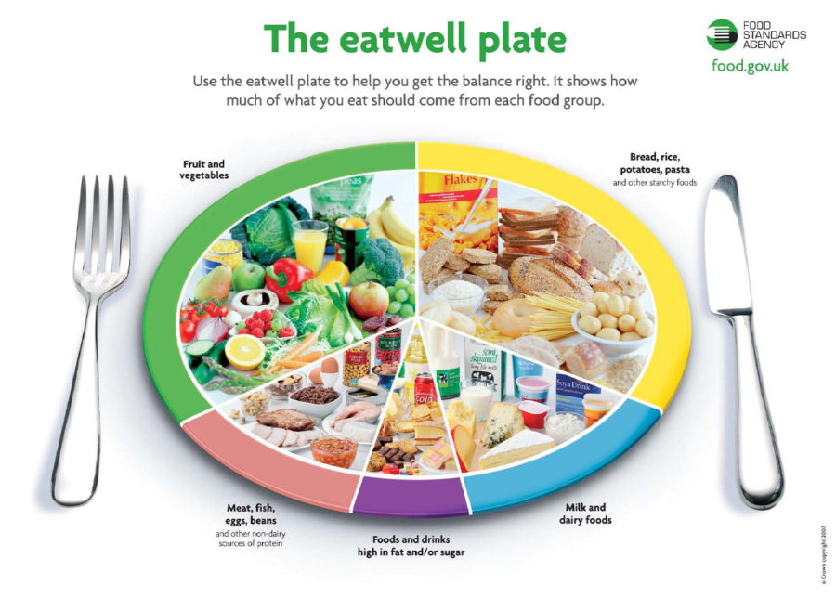
Water
Vitamin D
Potassium
Notes:
3
Explain that if you get some sun, drink plenty of water, and eats several foods from each food group, you are probably getting everything you need.
Explain that summer sun is important for vitamin D so its important to get outside and off the X-Box! However, too much sun makes our skin burn and that’s not healthy either. Just another example of the Goldilocks principle!
Just like in the Eatwell Plate lesson plan, remind that foods in the purple group can be included in small amounts if you like them, but we don’t need them to stay healthy. Also, most people have too many of these foods, partly because we see lots of adverts for them. (Link to “Food marketing and your health “ lesson plan.
NB: In the new “Eatwell guide”, most of the foods in this purple group are no shown outside the circle to make this clear.
At the end of this your pupils should have a better understanding of why it is important to:
Eat lots of different kinds of food
Eat regularly
Eat proper meals

Slide 4
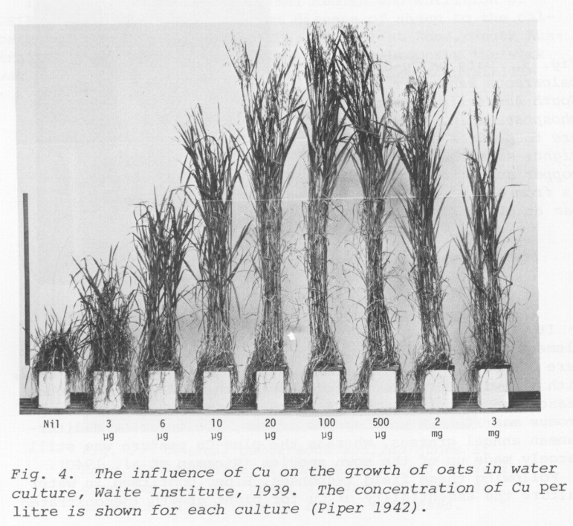
Effect of copper in the soil on growth of oats
Increasing level of Copper in Soil
Too little
Just right
Too much
Notes:
This slide shows what happens when we try to grow oats in soil with different levels of copper. Copper is a nutrient needed by oats. When the soil has enough copper, the oats grow really well. If it has too little, it hardly grows at all. If it has too much it also starts to suffer.
For the 40 nutrients we need, it is just the same. However, for us we usually get the right food for growth, but not always enough of the nutrients that help our brains and bodies work as well as they could.
For humans, our size does not give us much of an idea how healthy we are. Lots of nutrients affect our health without affecting our size. For example, eating green vegetables and oily fish gives us special nutrients that help our mood and concentration.
Healthy people come in all shapes and sizes and so do unhealthy people!

Slide 5




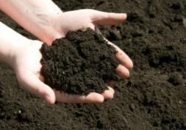
Air
C02
Oxygen
Water
“Nutrients” in soil
“Nutrients in food”
Nitrogen, Phosphorous, Magnesium, Sulphur, Potassium, Calcium and other minerals
Sun
Notes:
This slide just summarizes the similarities and differences between us and plants, We both need air, sun, water and nutrients. Just as plants need nutrients, we get nutrients when we eat them! The Eatwell Plate is like a guide to remind us of the different kinds of food our bodies need.

Slide 6
Nutrients often lacking in the diets of Scottish Teenagers
Nutrient | Impact
Iron | Mood, healthy blood
Magnesium | Mood, healthy heart
Zinc | Concentration, sleep, immune system, digestion
Folic Acid | Mood, sleep, healthy heart & blood
Vitamin A | Mood, healthy eyes & heart
Vitamin D | Mood, healthy bones, immune system
Omega 3 | Mood, concentration, healthy heart, immune system
Fibre | Mood, healthy gut & heart
How many of these “Nutrients” affect the brain?
Notes:
These nutrients are often lacking in the diets of teenagers in Scotland. Not having enough of then affects our long terms physical health. For example heart disease, strokes and cancer are all common causes of early death and illness that can be caused by a poor diet (and by other things too – Inactivity, luck, genetics, smoking, alcohol, drugs etc).
Lacking these nutrients can also affect our health now. It can especially affect how our brains work. That means that our concentration, mood and sleep can all be affected. Getting you diet right can help you to learn, concentrate, be happy, relax and sleep. How many of these things do you sometimes find hard to do? There could be lots of reasons, but your diet can be one of them.

Slide 7
Eatwell, Physical Activity & the Impact on Specific Parts of the Body
As well as the brain, other parts of our body need us to be:
Be physically active
Eat enough of the right nutrients.
Good examples include:
Heart
Lungs
Muscles
Bones
How are these parts of our body affected by our food choices and levels of physical activity?
Notes:
This slide links you to an optional lesson plan called “Physical Activity Eatwell & Body Parts” (See folder)
from the Primary High 5 programme. You can use this lesson as it stands, or just use information from it in whatever way you see fit.
Having looked at the importance of a varied diet to give all the nutrients we need, the next two slides focus on the importance of eating regularly and eating fewer highly processed foods. They also create a link to some further learning about sugar and fibre.

Slide 8
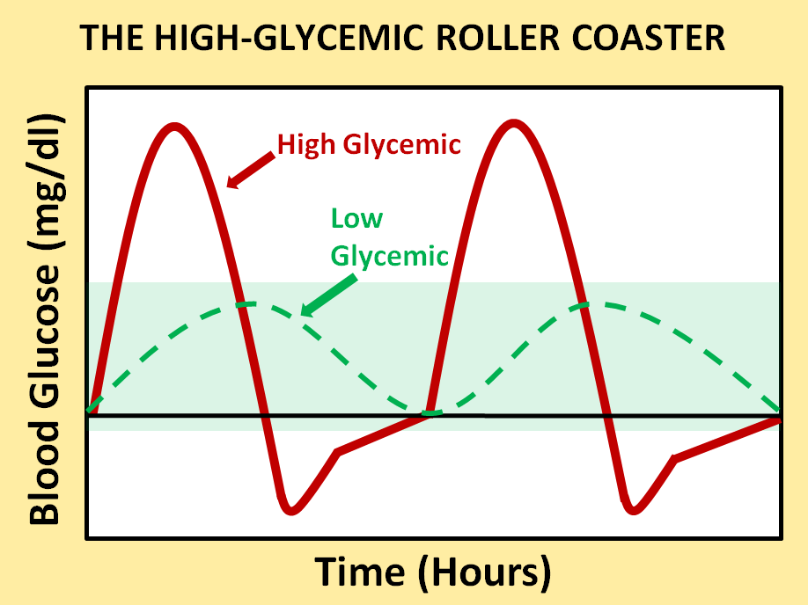
The Sugar Roller Coaster
Sugar
Fibre
Calm & focused
Poor mood & concentration
Notes:
You can use this slide to help pupils understand how the amount, timing and type of food they eat affects their mood and concentration in the short term. It compliments the breakfast cereal lesson plans in particular.
Explain that it is normal to have sugar in our blood.
When we digest food, the break it down and the level of sugar in our blood goes up.
We call this sugar “glucose”.
If we eat lots of sugary food but not much fibre, the glucose in our blood rises quickly but falls very quickly too (red line).
A rapid fall in blood glucose happens and hour or two after eating high sugar foods that are also low in fibre.
Can they name a breakfast cereal that might have this effect?
Also, if we skip breakfast, our blood glucose is low when we wake up, but is gets lower during the morning.
When our blood glucose falls too fast, we become grumpy and find it hard to concentrate. (Click through the slide so that the green and red bars with writing appear)
If we eat food that is high in fibre, it takes longer to digest. This means that our blood sugar rises more slowly and falls more slowly (Green dotted line).
What could we have for breakfast that is high in fibre and takes a long time to digest?
How would we feel if we only ate high sugar foods that are low in fibre?
How would we feel if we skipped a meal completely?
What other meals would help keep us calm and focused?

Slide 9

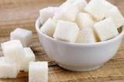

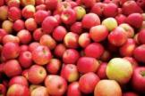

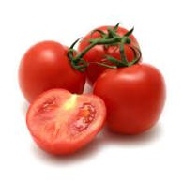
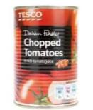

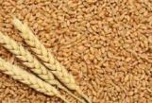
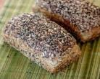

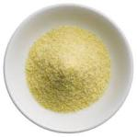


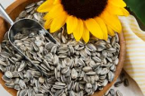
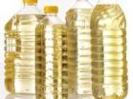
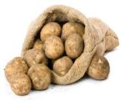
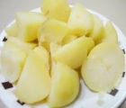

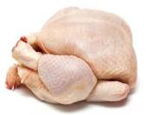

What gets removed?
What gets added?
Which can you eat to excess?
Notes:
As each food gets more heavily processed, we lose more nutrients and fibre, but add more fat, sugar, salt or chemicals.
Some transformations are fine and just practical. For example, wholemeal bread is easier to eat and digest than wheat grains. Canned tomatoes are convenient in winter. However, usually, as foods get more heavily processed, they lose their nutritional benefits and instead become convenient commodities that are profitable to transport, store, advertise and trade, but not so good for our health.
Eating fewer processed foods is therefore a good principle to stick to.
What next?
These two slides can be referred to again when pupils have covered some more lesson plans on sugar and fibre (See “Nutrition progression” folder for further details).

