Slide 1
Everyday foods for:
Strong Bones and Teeth

Slide 2

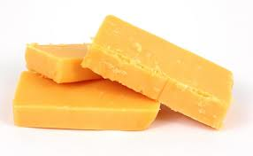
Cheese

Slide 3
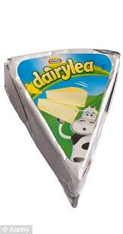
Cheese
Spread

Slide 4
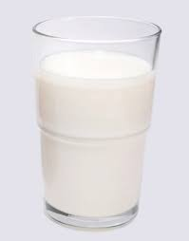
Milk

Slide 5
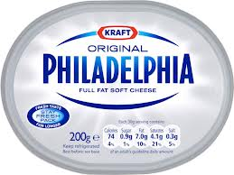
Cream Cheese

Slide 6
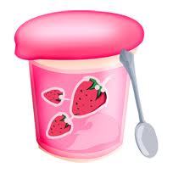
Yoghurt

