Slide 1
Eat when you are hungry. Stop when you are full.

Slide 2
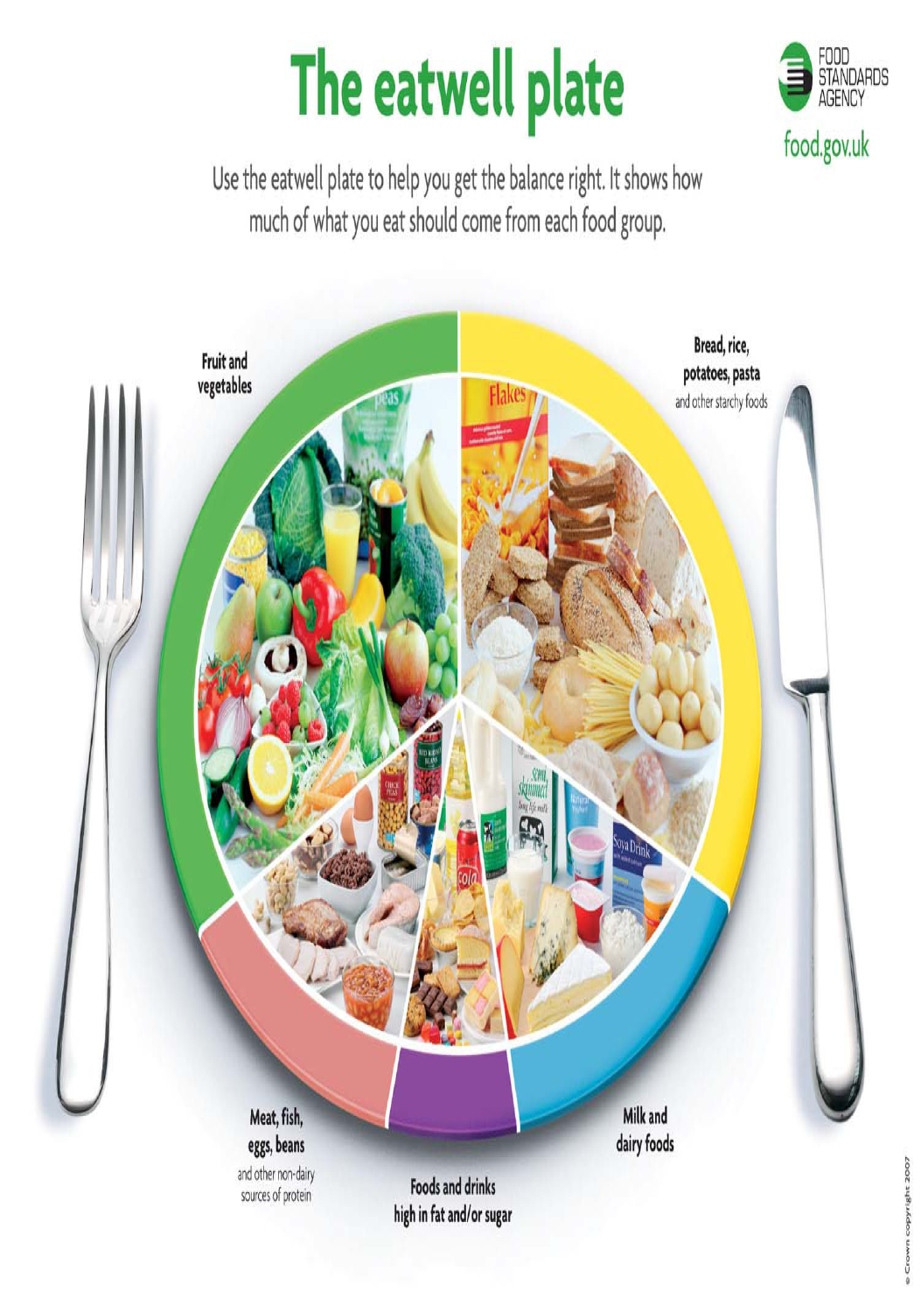

Slide 3
Teacher’s notes on the Eatwell Plate / guide transition
The Eatwell Plate was replaced with the Eatwell Guide in 2016.
(The old Eatwell plate is shown in slide 3)
The main change is that most of the purple group is now shown outside of the plate (bottom left) to make it clear that these do not need to be included.
As before, these foods are to be eaten “Less often and in small amounts”. In Highland we like to call these “Sometimes foods” (not bad foods, unhealthy foods or treats).
The word “plate” and the knife and fork have been removed. This is to make it clear that the need to include all the groups is for the diet overall rather than at each individual meal
Another helpful addition in the top right is to encourage us to drink plenty of fluid.
The official Eatwell Guide has calorie information for adults. This is not helpful for children so we’ve replaced this with the words “Eat when you are hungry, stop when you are full”

