Slide 1
Sometimes Foods & Everyday Foods

Slide 2
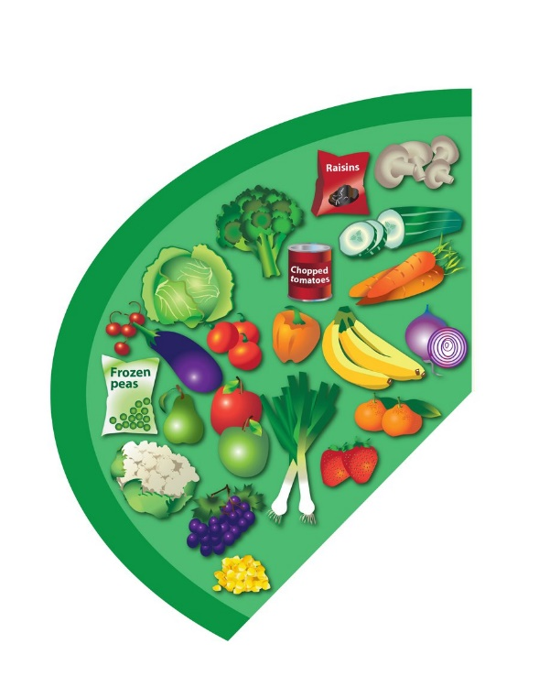
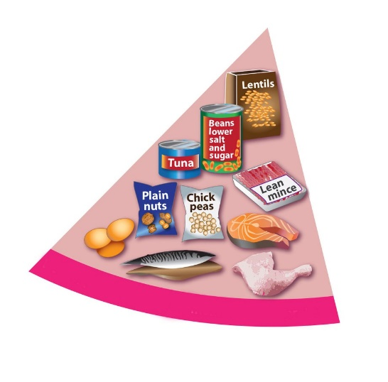
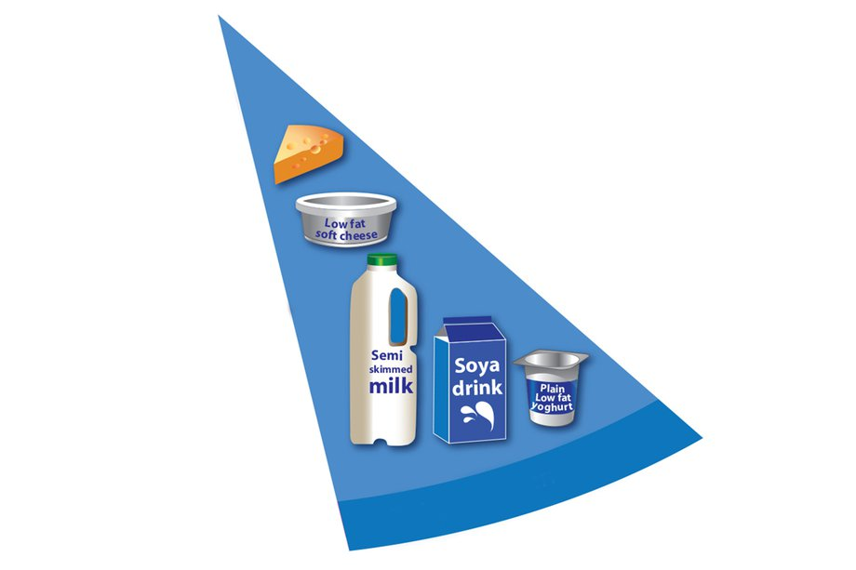
Everyday Foods

Slide 3
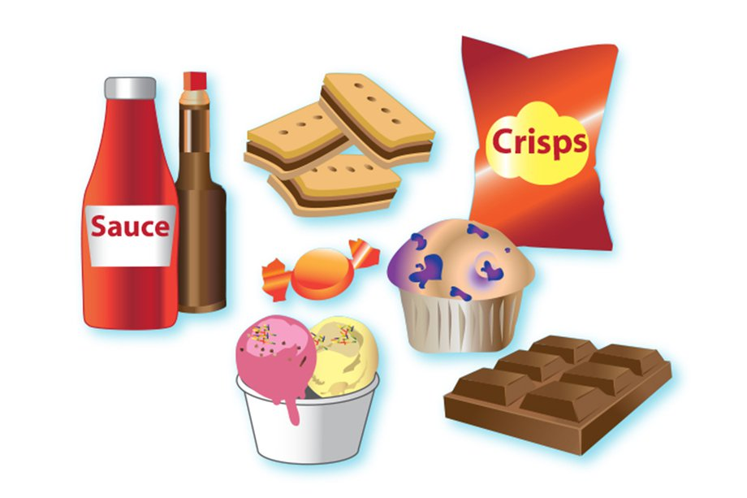
What word or words would we use to describe these foods?
Sometimes Foods

Slide 4
Everyday foods that give us:
ENERGY

Slide 5
Everyday foods for:
Strong Bones and Teeth

Slide 6
Everyday Foods that:
Help us Grow

Slide 7
Everyday Foods for:
A Healthy Heart

